Slide 1

Test automation Lesson 2
Dmitri Gradinar

Slide 2
UML
The Unified Modeling Language (UML) is a general-purpose, developmental, modeling language in the field of software engineering, that is intended to provide a standard way to visualize the design of a system.

Slide 3
UML - Class Diagram
Used for describing structure and behavior in the use cases
Provide a conceptual model of the system in terms of entities and their relationships

Slide 4
UML - Class Diagram Representation of Class
Class is represented with boxes which contain three parts:
Name
Attributes
Operations

Slide 5
UML - Class Diagram Modifiers are used to indicate visibility of attributes and operations
‘+’ is used to denote Public visibility (everyone)
‘#’ is used to denote Protected visibility (friends and derived)
‘-’ is used to denote Private visibility (no one)

Slide 6
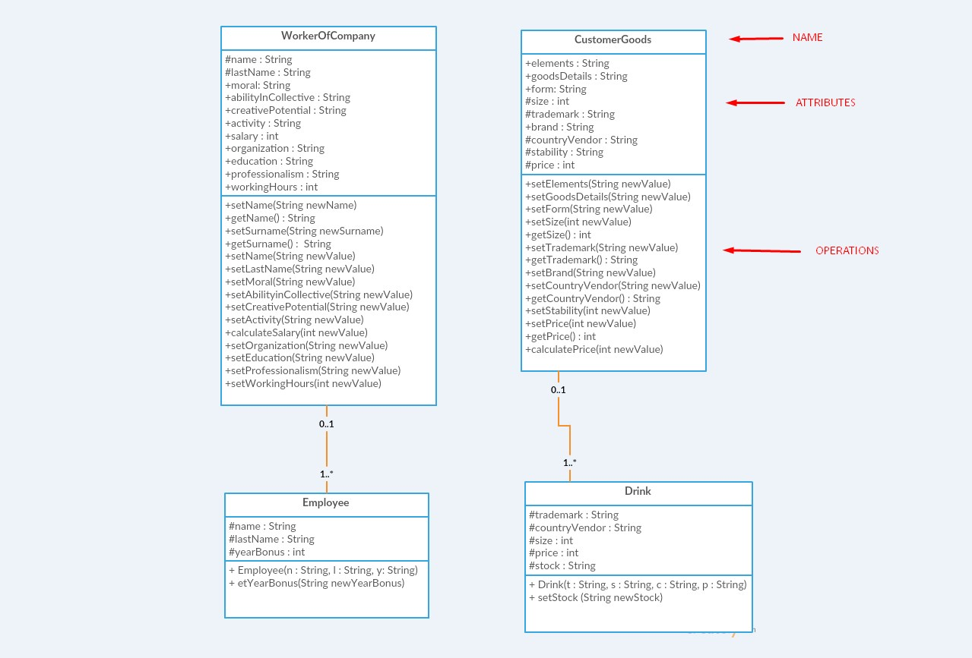
UML - Class Diagram Example

Slide 7
UML - Class Diagram Relationships or Notation of class Diagram
There are two kinds of Relationships
Generalization (parent-child relationship)
Association (student enrolls in course)
Associations can be further classified as
Aggregation
Composition

Slide 8
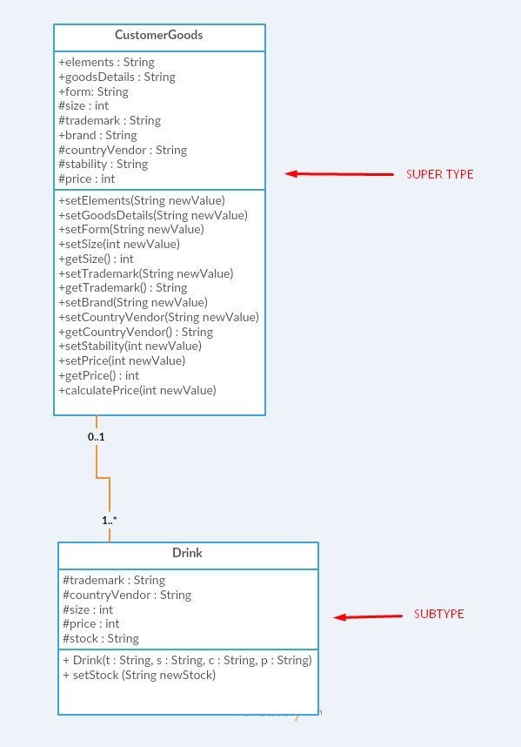
UML - Class Diagram Generelization
Generalization expresses a parent/child relationship among related classes

Slide 9
UML - Class Diagram Association
Associations represent relationships between instances of classes.
An association is a link connecting two classes.
Bi-directional association Associations are assumed to be bi-directional e.g. Flight and plane notation:
Uni-directional association e.g. Order and item notation:

Slide 10
UML - Class Diagram Composition
Composition: expresses a relationship among instances of related classes. It is a specific kind of Whole-Part relationship
t expresses a relationship where an instance of the Whole-class has the responsibility to create and initialize instances of each Part-class.

Slide 11
UML - Class Diagram Composition
Example
Person
Legs
Hands

Slide 12
UML - Class Diagram Aggregation
Aggregation: expresses a relationship among instances of related classes. It is a specific kind of Container Containee relationship.
It expresses a relationship where an instance of the Container-class has the responsibility to hold and maintain instances of each Containee-class that have been created outside the auspices of the Container-class

Slide 13
UML - Class Diagram Aggregation
Example
Bag
Books
Apples

Slide 14
Java

Slide 15
Java Basic Datatypes
byte:
Byte data type is an 8-bit signed two's complement integer.
Minimum value is -128 (-2^7)
Maximum value is 127 (inclusive)(2^7 -1)
Default value is 0
Byte data type is used to save space in large arrays, mainly in place of integers, since a byte is four times smaller than an int.
Example: byte a = 100 , byte b = -50

Slide 16
Java Basic Datatypes
short:
Short data type is a 16-bit signed two's complement integer.
Minimum value is -32,768 (-2^15)
Maximum value is 32,767 (inclusive) (2^15 -1)
Short data type can also be used to save memory as byte data type. A short is 2 times smaller than an int
Default value is 0.
Example: short s = 10000, short r = -20000

Slide 17
Java Basic Datatypes
int:
Int data type is a 32-bit signed two's complement integer.
Minimum value is - 2,147,483,648.(-2^31)
Maximum value is 2,147,483,647(inclusive).(2^31 -1)
Int is generally used as the default data type for integral values unless there is a concern about memory.
The default value is 0.
Example: int a = 100000, int b = -200000

Slide 18
Java Basic Datatypes
long:
Long data type is a 64-bit signed two's complement integer.
Minimum value is -9,223,372,036,854,775,808.(-2^63)
Maximum value is 9,223,372,036,854,775,807 (inclusive). (2^63 -1)
This type is used when a wider range than int is needed.
Default value is 0L.
Example: long a = 100000L, long b = -200000L

Slide 19
Java Basic Datatypes
float:
Float data type is a single-precision 32-bit IEEE 754 floating point.
Float is mainly used to save memory in large arrays of floating point numbers.
Default value is 0.0f.
Float data type is never used for precise values such as currency.
Example: float f1 = 234.5f

Slide 20
Java Basic Datatypes
double:
double data type is a double-precision 64-bit IEEE 754 floating point.
This data type is generally used as the default data type for decimal values, generally the default choice.
Double data type should never be used for precise values such as currency.
Default value is 0.0d.
Example: double d1 = 123.4

Slide 21
Java Basic Datatypes
boolean:
boolean data type represents one bit of information.
There are only two possible values: true and false.
This data type is used for simple flags that track true/false conditions.
Default value is false.
Example: boolean one = true

Slide 22
Java Basic Datatypes
char:
char data type is a single 16-bit Unicode character.
Minimum value is '\u0000' (or 0).
Maximum value is '\uffff' (or 65,535 inclusive).
Char data type is used to store any character.
Example: char letterA ='A'

Slide 23
Java Literals
A literal is a source code representation of a fixed value. They are represented directly in the code without any computation.
Literals can be assigned to any primitive type variable. For example:
byte, int, long, and short can be expressed in decimal(base 10), hexadecimal(base 16) or octal(base 8) number systems as well.

Slide 24


Java Literals
Prefix 0 is used to indicate octal and prefix 0x indicates hexadecimal when using these number systems for literals. For example:
String literals in Java are specified like they are in most other languages by enclosing a sequence of characters between a pair of double quotes. Examples of string literals are:

Slide 25
Java Literals
String and char types of literals can contain any Unicode characters. For example:

Slide 26
Java Access Modifiers
Java provides a number of access modifiers to set access levels for classes, variables, methods and constructors. The four access levels are:
Visible to the package. the default. No modifiers are needed.
Visible to the class only (private).
Visible to the world (public).
Visible to the package and all subclasses (protected).

Slide 27

Java Access Modifiers
Default Access Modifier - No keyword:
Default access modifier means we do not explicitly declare an access modifier for a class, field, method, etc.
A variable or method declared without any access control modifier is available to any other class in the same package. The fields in an interface are implicitly public static final and the methods in an interface are by default public.
Example:
Variables and methods can be declared without any modifiers, as in the following examples:

Slide 28
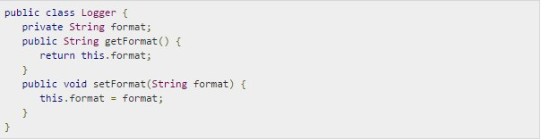
Java Access Modifiers
Private Access Modifier - private:
Methods, Variables and Constructors that are declared private can only be accessed within the declared class itself.
Private access modifier is the most restrictive access level. Class and interfaces cannot be private.
Variables that are declared private can be accessed outside the class if public getter methods are present in the class.
Using the private modifier is the main way that an object encapsulates itself and hide data from the outside world.
Example:
The following class uses private access control:

Slide 29

Java Access Modifiers
Public Access Modifier - public:
A class, method, constructor, interface etc declared public can be accessed from any other class. Therefore fields, methods, blocks declared inside a public class can be accessed from any class belonging to the Java Universe.
However if the public class we are trying to access is in a different package, then the public class still need to be imported.
Because of class inheritance, all public methods and variables of a class are inherited by its subclasses.
Example:
The following function uses public access control:

Slide 30
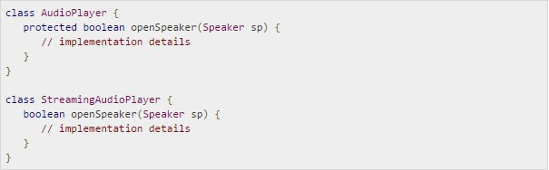
Java Access Modifiers
Protected Access Modifier - protected:
Variables, methods and constructors which are declared protected in a superclass can be accessed only by the subclasses in other package or any class within the package of the protected members' class.
The protected access modifier cannot be applied to class and interfaces. Methods, fields can be declared protected, however methods and fields in a interface cannot be declared protected.
Protected access gives the subclass a chance to use the helper method or variable, while preventing a nonrelated class from trying to use it.
Example:
The following parent class uses protected access control, to allow its child class override openSpeaker() method:

Slide 31
JAVA CONSTRUCTORS
A java constructor has the same name as the name of the class to which it belongs. Constructor’s syntax does not include a return type, since constructors never return a value.
Constructors may include parameters of various types. When the constructor is invoked using the new operator, the types must match those that are specified in the constructor definition.
Java provides a default constructor which takes no arguments and performs no special actions or initializations, when no explicit constructors are provided.
The only action taken by the implicit default constructor is to call the superclass constructor using the super() call. Constructor arguments provide you with a way to provide parameters for the initialization of an object.

Slide 32
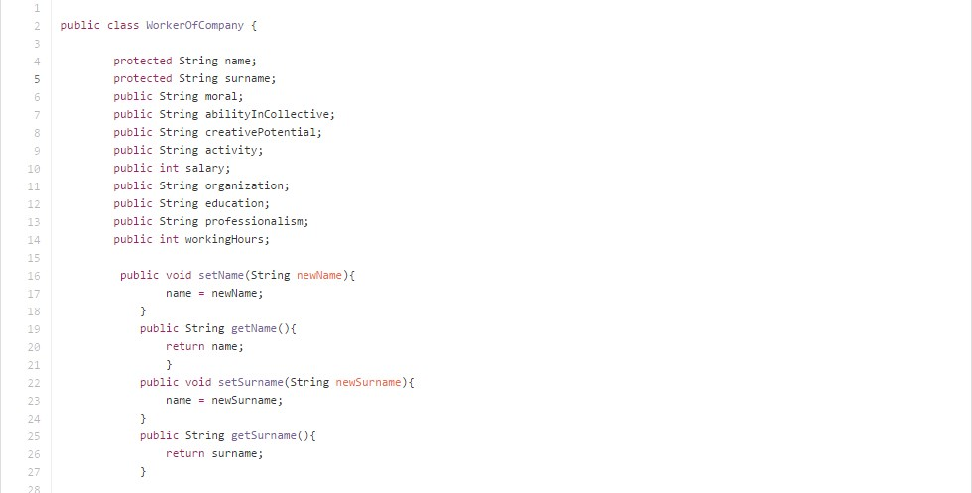
JAVA CONSTRUCTORS

Slide 33
JAVA THIS
Within an instance method or a constructor, this is a reference to the current object — the object whose method or constructor is being called. You can refer to any member of the current object from within an instance method or a constructor by using this.

Slide 34
JAVA THIS
sing this with a Field
The most common reason for using the this keyword is because a field is shadowed by a method or constructor parameter.
For example, the Point class was written like this
public class Point {
public int x = 0;
public int y = 0;
//constructor public
Point(int a, int b) {
x = a;
y = b;
}
}

Slide 35
JAVA THIS
but it could have been written like this:
public class Point {
public int x = 0;
public int y = 0;
//constructor public
Point(int x, int y) {
this.x = x;
this.y = y;
}
}

Slide 36
JAVA VOID
The void type, in several programming languages derived from C and Algol68, is the type for the result of a function that returns normally, but does not provide a result value to its caller. Usually such functions are called for their side effects, such as performing some task or writing to their output parameters. The usage of the void type in such context is comparable to that of the syntactic constructs which define subroutines in Visual Basic and procedures in Pascal. It is also similar to the unit type used in functional programming languages and type theory; however, there are some differences in allowable usage, in that the void type is taken to be an empty type with no values. See Unit type#In programming languages for a comparison.
C and C++ also support the pointer to void type (specified as void *), but this is an unrelated notion. Variables of this type are pointers to data of an unspecifiedtype, so in this context (but not the others) void * acts as a universal or top type. A program can probably convert a pointer to any type of data (except a function pointer) to a pointer to void and back to the original type without losing information, which makes these pointers useful for polymorphic functions. The C language standard does not guarantee that the different pointer types have the same size.
void massage ()

Slide 37
JAVA Object & Classes
Java is an Object-Oriented Language. As a language that has the Object Oriented feature, Java supports the following fundamental concepts:
Polymorphism
Inheritance
Encapsulation
Abstraction
Classes
Objects
Instance
Method
Message Parsing
In this chapter, we will look into the concepts Classes and Objects.
Object - Objects have states and behaviors. Example: A dog has states - color, name, breed as well as behaviors -wagging, barking, eating. An object is an instance of a class.
Class - A class can be defined as a template/blue print that describes the behaviors/states that object of its type support.

Slide 38
JAVA Object & Classes
Objects in Java:
Let us now look deep into what are objects. If we consider the real-world we can find many objects around us, Cars, Dogs, Humans, etc. All these objects have a state and behavior.
If we consider a dog, then its state is - name, breed, color, and the behavior is - barking, wagging, running
If you compare the software object with a real world object, they have very similar characteristics.
Software objects also have a state and behavior. A software object's state is stored in fields and behavior is shown via methods.
So in software development, methods operate on the internal state of an object and the object-to-object communication is done via methods.

Slide 39
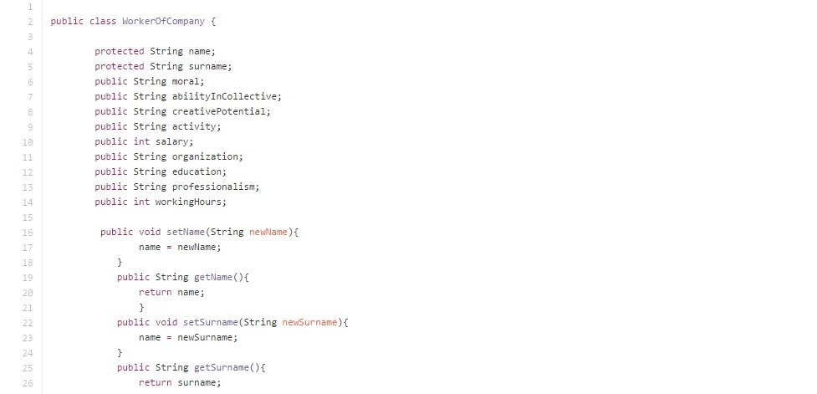
JAVA Object & Classes
Classes in Java:

Slide 40


